Slide 1
Collections
A collection is an object that groups multiple elements together.
A collection is used to store, retrieve and manipulate data elements of the group.
A LinkedList holds a collection of objects
LinkedList<Customer> customerList = new LinkedList<Customer>();
When we declare <Customer>, we are declaring the type of collection the LinkedList will hold.

Slide 2
A Group Class
A common pattern is to store the list in its own class
class Objects
{
private LinkedList<Object> objectList = new LinkedList<Object>();
public void method()
{
for (Object object: objectList)
object.method();
}
}

Slide 3
A Group Class - Customers
A common pattern is to store the list in its own class
class Customers
{
private LinkedList<Customer> customerList = new LinkedList<Customer>();
public void method()
{
for (Customer cust: customerList)
cust.method();
}
}

Slide 4
List Lookup Pattern
A common pattern is to give each object an id. To find an object in the list, we can scan each object until we find one that matches.
The supplier offers a boolean method
public boolean matches(int id)
{ return this.id == id; }
The client scans the list and returns the matching object
private Object find(int id)
{ for (Object object: objects)
if (object.matches(id))
return object;
return null; }

Slide 5
List Lookup - Customers
Each Customer object has an id. To find a Customer in the list, we can scan each object until we find one with a matching id.
The Customer offers the boolean method matches()
public boolean matches(int id)
{ return this.id == id; }
Customers class scans the list and returns a matching object
private Customer find(int id)
{ for (Customer cust: customerList)
if (cust.matches(id))
return cust;
return null; }

Slide 6
Group Class – Inheritance
Adding any type of object to a linked list is done the same way:
customerList.add(new Customer(111, “Kelly”, 12));
bookList.add(new Book(333, “Harry Potter”));
Finding any type of object in a list is done the same way (list lookup) :
customerList.find(111); -> calls matches(int id) for each object
bookList.find(333); -> calls matches(int id) for each object

Slide 7
Parent Group Class
All common operations like add, find can be grouped in a PARENT class so we don’t repeat the code in each group class:
Records: Parent Group Class
private LinkedList<Record> recordList = new LinkedList<Record>();
recordList.add(new Customer(111, “Kelly”, 12));
recordList.add(new Book(333, “Harry Potter”));
recordList.find(333);
recordList.toString();
RULE:
Record is a parent class for Customer & Book

Slide 8
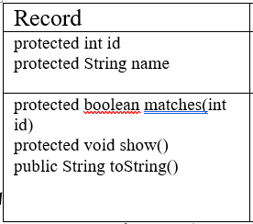
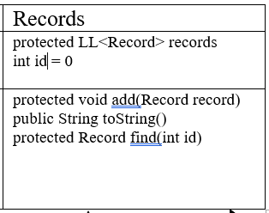
Group Class - Inheritance

Slide 9
OO Design Steps
Identify Objects
Find Common Code
Create Group classes
Create classes, attributes & methods
Refactor for parent class
Implement list lookup pattern

